Slide 1
How to make a Package
Overview

Slide 2
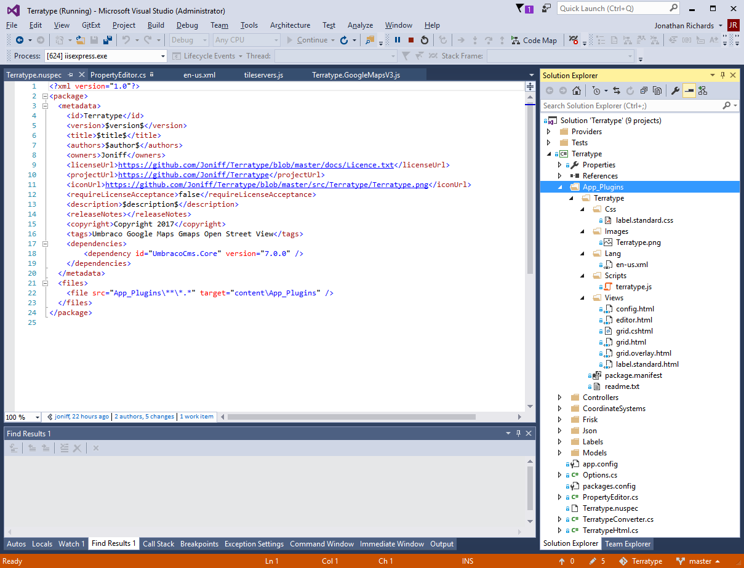
Make a new class library project
Install Umbraco.Core using Nuget
Make an App_Plugins Folder
Add the static files that will end up in the App_Plugins Folder when installed. Everything else in the class library will create a dll that will end up in the bin folder of the Umbraco site.
Create a nuspec file, that will auto generate a Nuget File – Notice the <file> command on Line 22, which embeds all the static files into the NuGet package

Slide 3
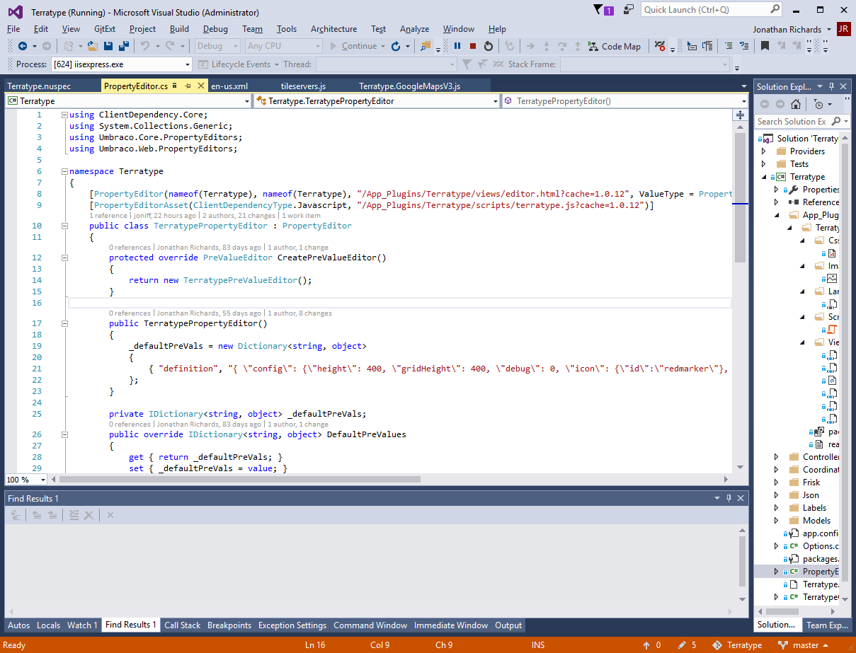
Create a class file
Inherit from PropertyEditor class
Decorate class. Note the use of a cache parameter on filenames to force browsers to load the latest version of each file, if the user updates this package from a previous version

Slide 4
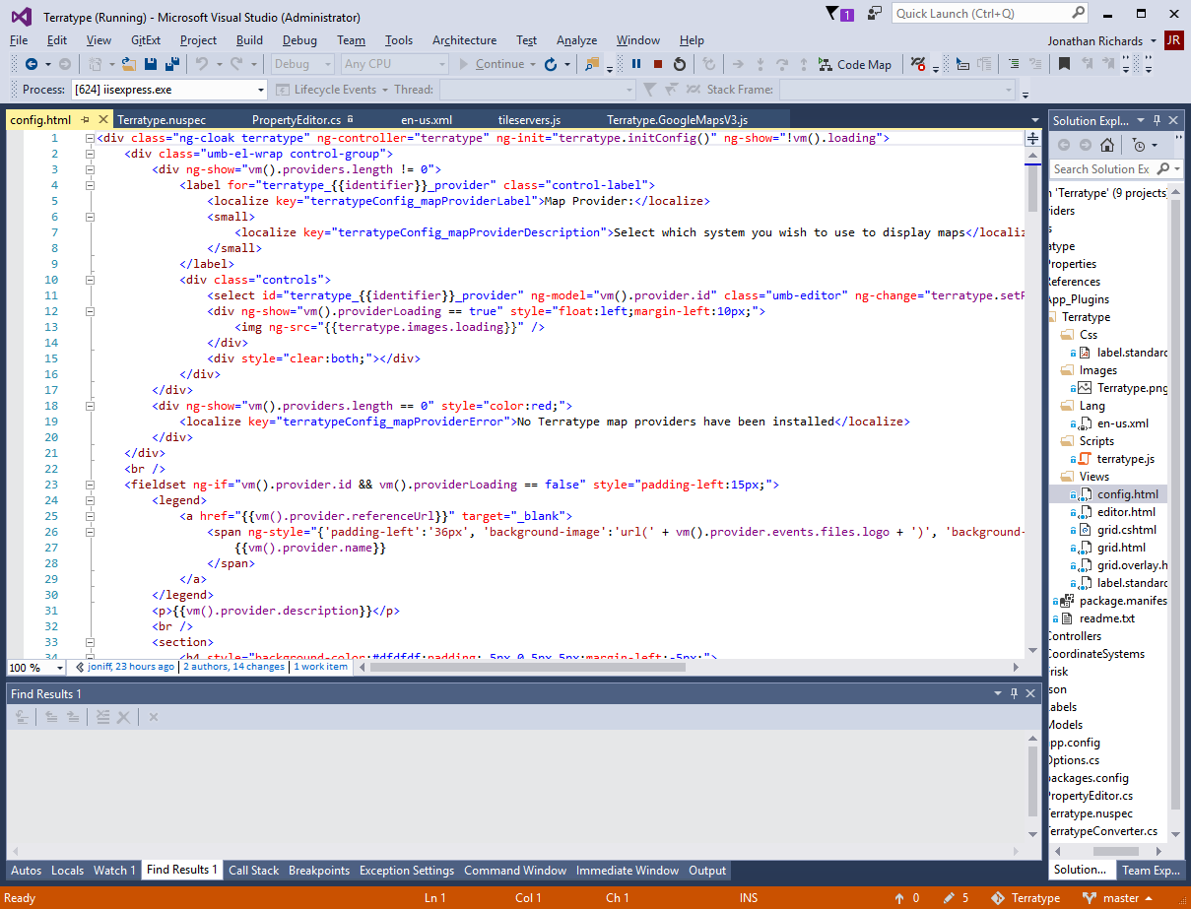
Put html in html file
Notice the ng-controller attribute, this is Angular 1. It informs what javascript will run when this html is viewed

Slide 5
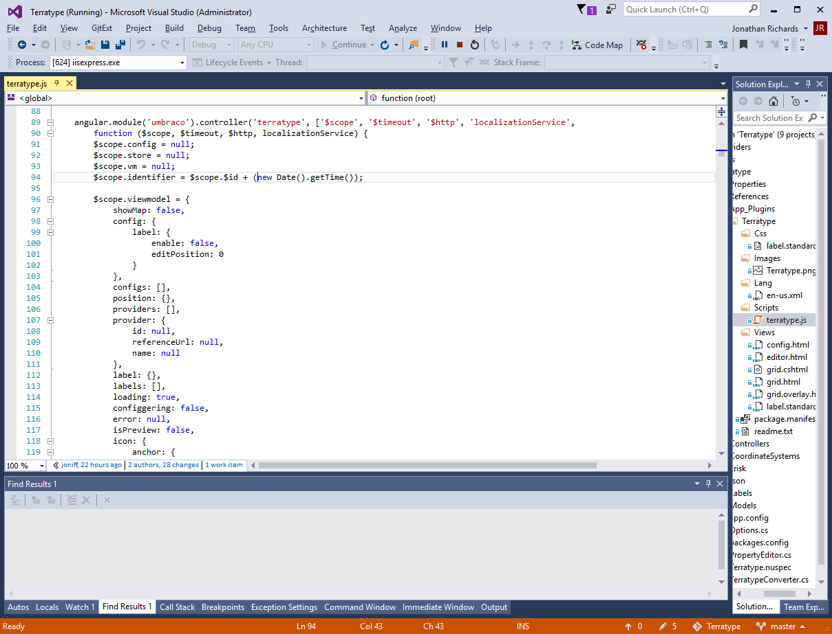
This is the javascript file, it has the Angular 1 code that runs when the html is viewed

Slide 6
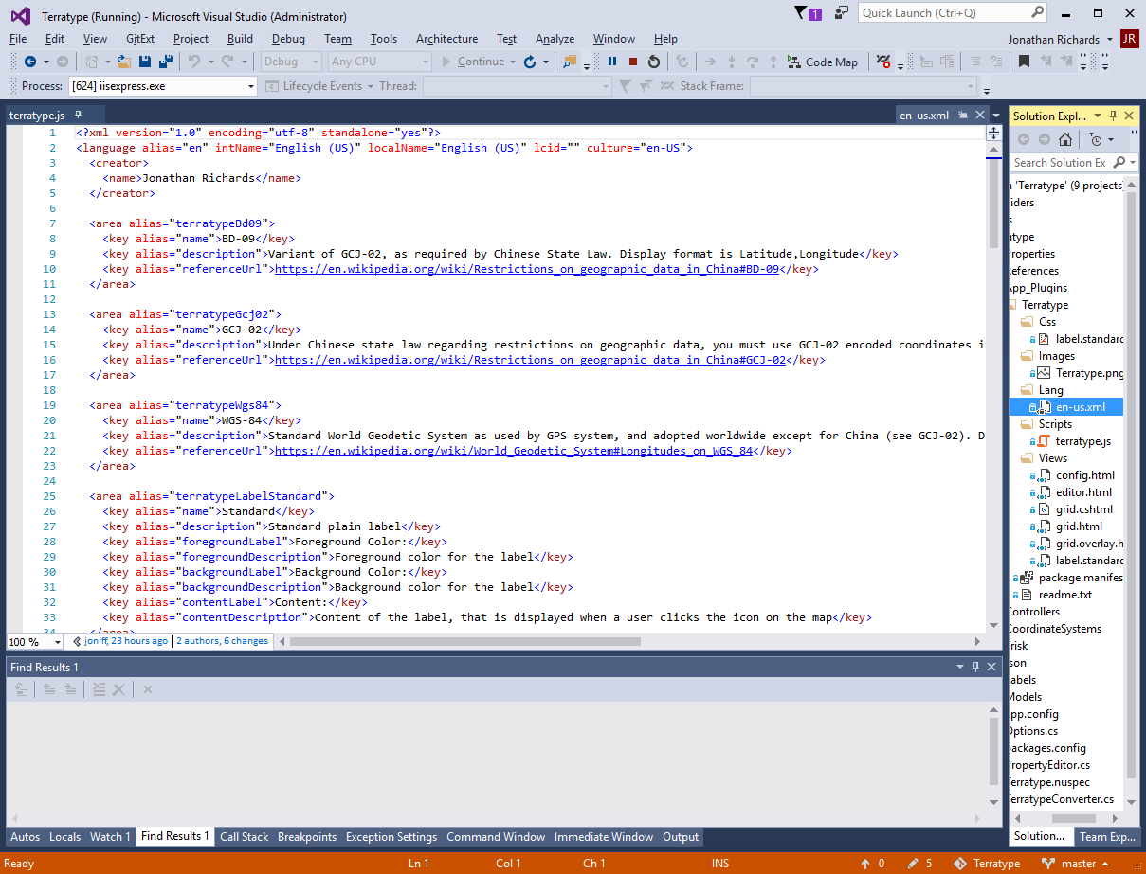
Umbraco will load any language files it can find in the App_Plugins folder as long as they are in a /lang/ folder and have a name that matches a culture.
Its is much quicker to start the language file at the same time as the writing the package, then going through an existing package adding language strings.

Slide 7
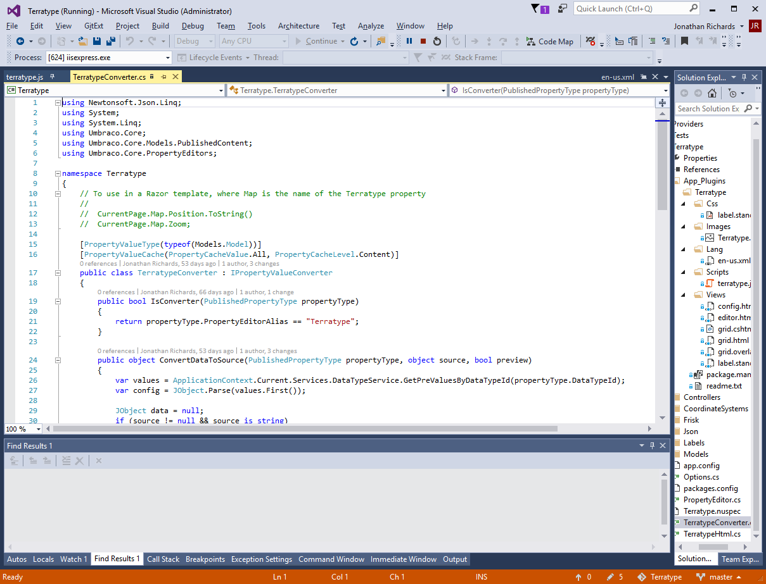
At some point you will want a strongly typed view of your new property type. This is simple to do, just inherit from IPropertyValueConvertor and set the Alias Type to the name of your Property. Your code will now be automatically run whenever Umbraco wishes to deserialize your datatype

Slide 8
At some point you will want a strongly typed view of your new property type. This is simple to do, just inherit from IPropertyValueConvertor and set the Alias Type to the name of your Property. Your code will now be automatically run whenever Umbraco wishes to deserialize your datatype

Slide 9
At some point you will want a strongly typed view of your new property type. This is simple to do, just inherit from IPropertyValueConvertor and set the Alias Type to the name of your Property. Your code will now be automatically run whenever Umbraco wishes to deserialize your datatype

Slide 10
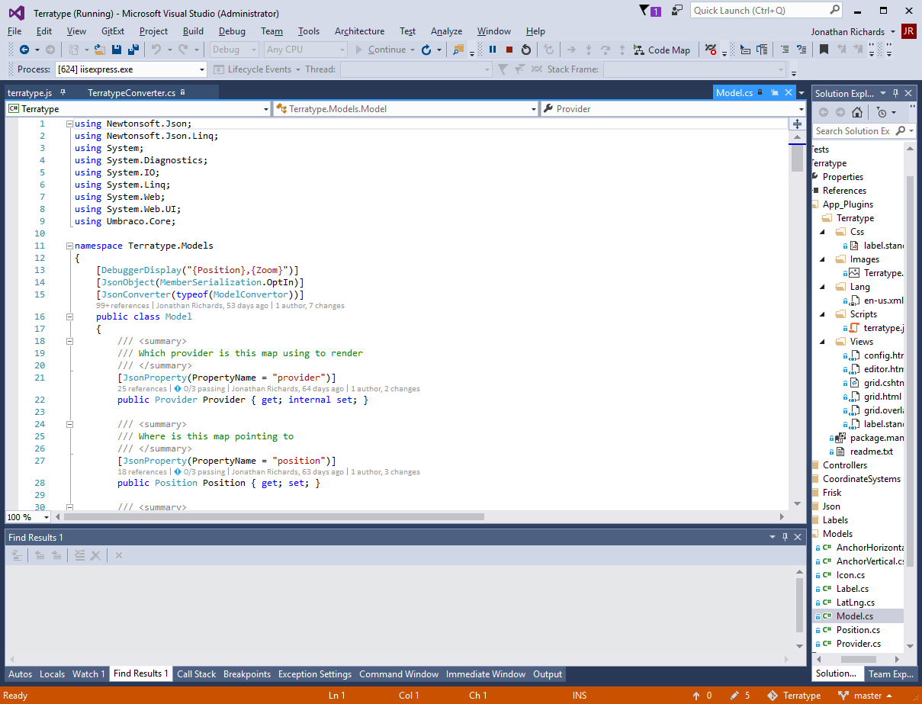
Create a class that represents this strong typed version of your property type. Decorate with JsonConvertor commands so that users can serialise and deserialise into and out of your class

Slide 11
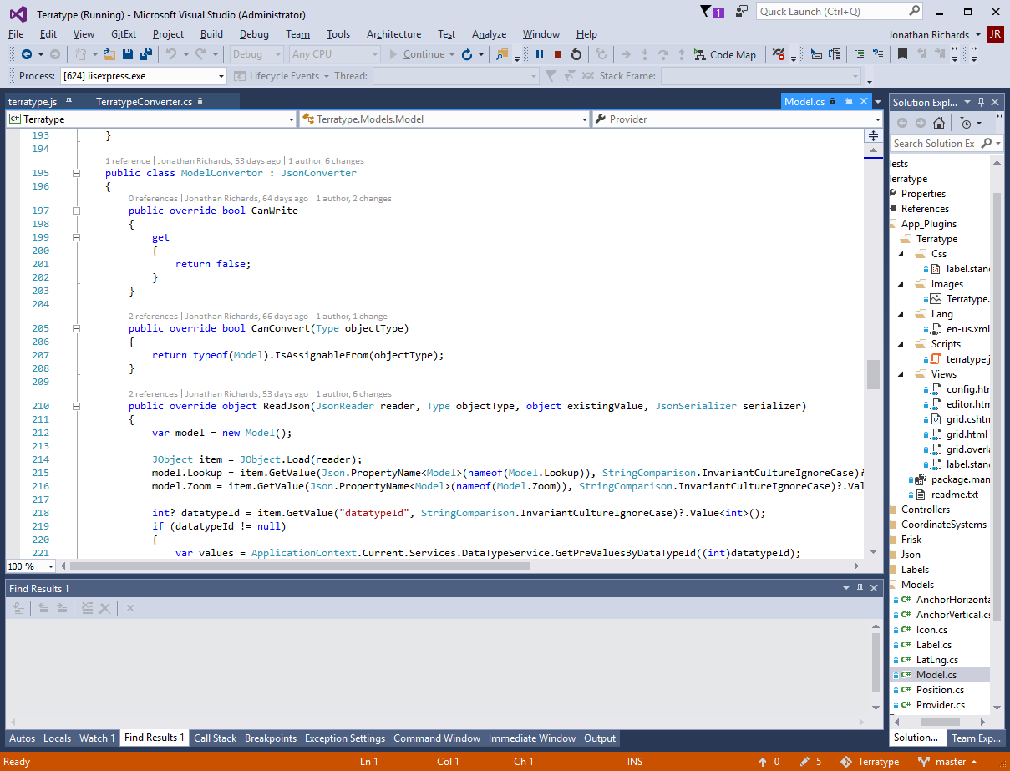
If you need more control over serialising and deserialing, create a class that inherits from JsonConverter – this will be used to serialize and deserialse instead

Slide 12
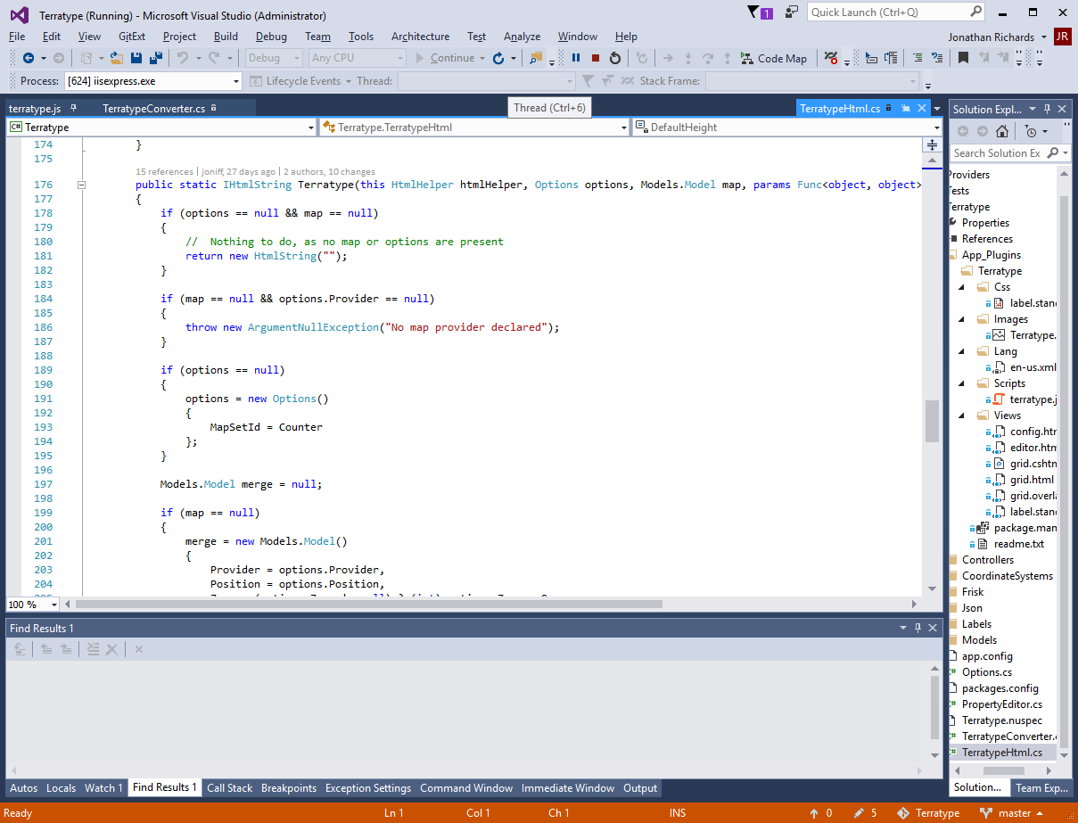
To create a razor renderer for your datatype, create a static class and add an extension method to HtmlHelper that takes a strongly typed version of
Return an IHtmlString that contains real Html that will be displayed in the browser

Slide 13
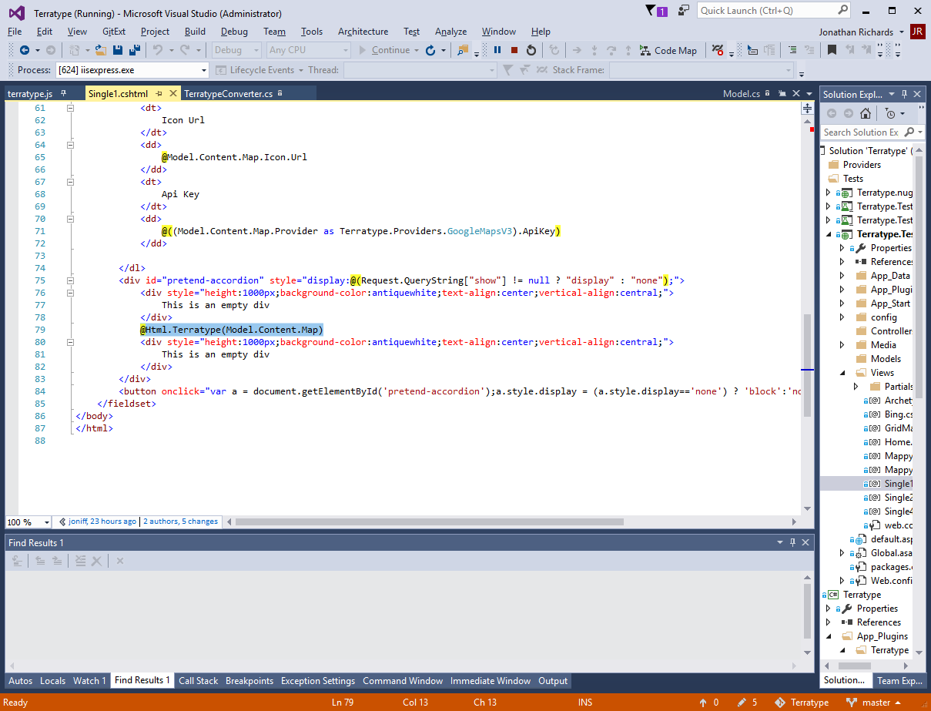
Example of how to call the renderer inside a Razor view

Slide 14
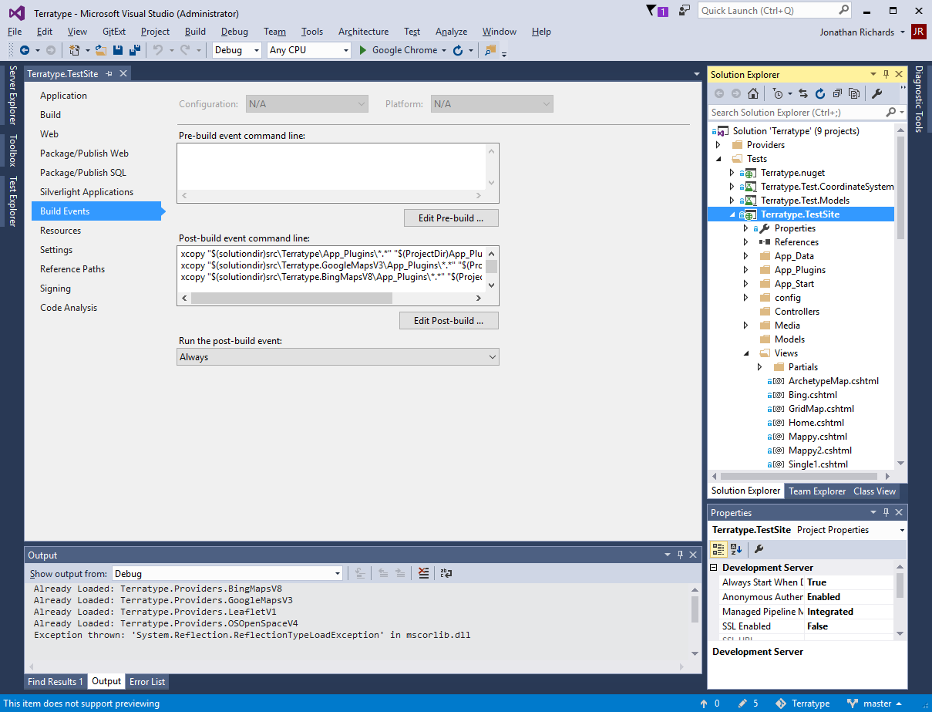
To test your new property type. Create a new website inside your Visual Studio solution
Use NuGet to install the latest version of Umbraco.
As normal, run your new website to run the Umbraco installer. There will be nothing special you will need to do when installing Umbraco database. Though for easy of mind later, make the admin user name and password something simple so that others can use your test website
In your post build events for website, copy all the static files in App_Plugins into your website.
Also create a reference to your class library too

Slide 15
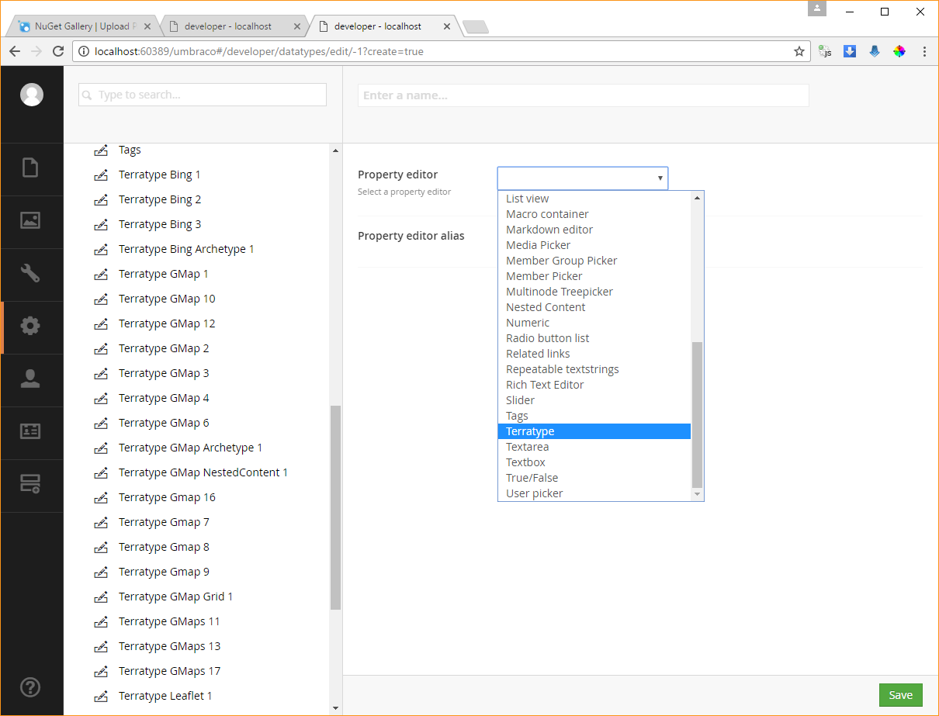
Include your If you have done all the previous steps right. When you run your test website you should see your new property type.
Test your property type by creating doctypes and content, just like normal.

Slide 16
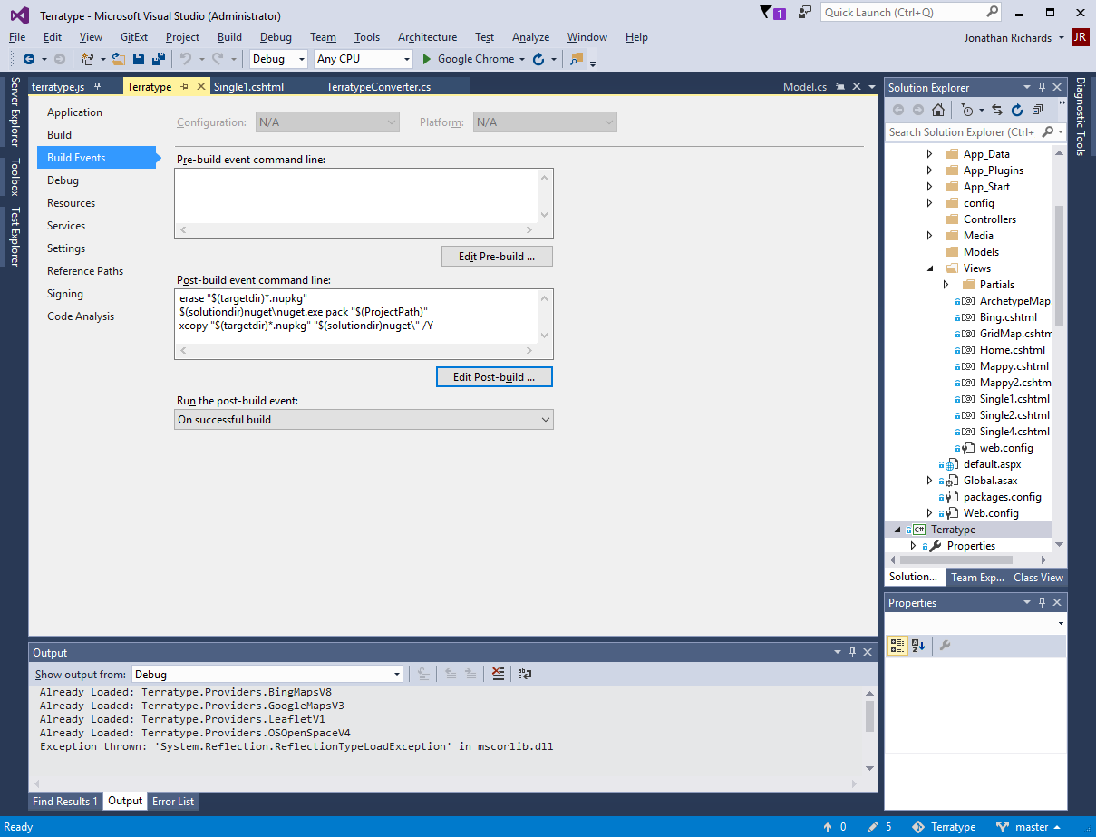
Everytime you build your project, a NuGet package file will be generated in your /bin/debug folder. Feel free to copy this to a more suitable location – like show in the screenshot with the post build event

Slide 17
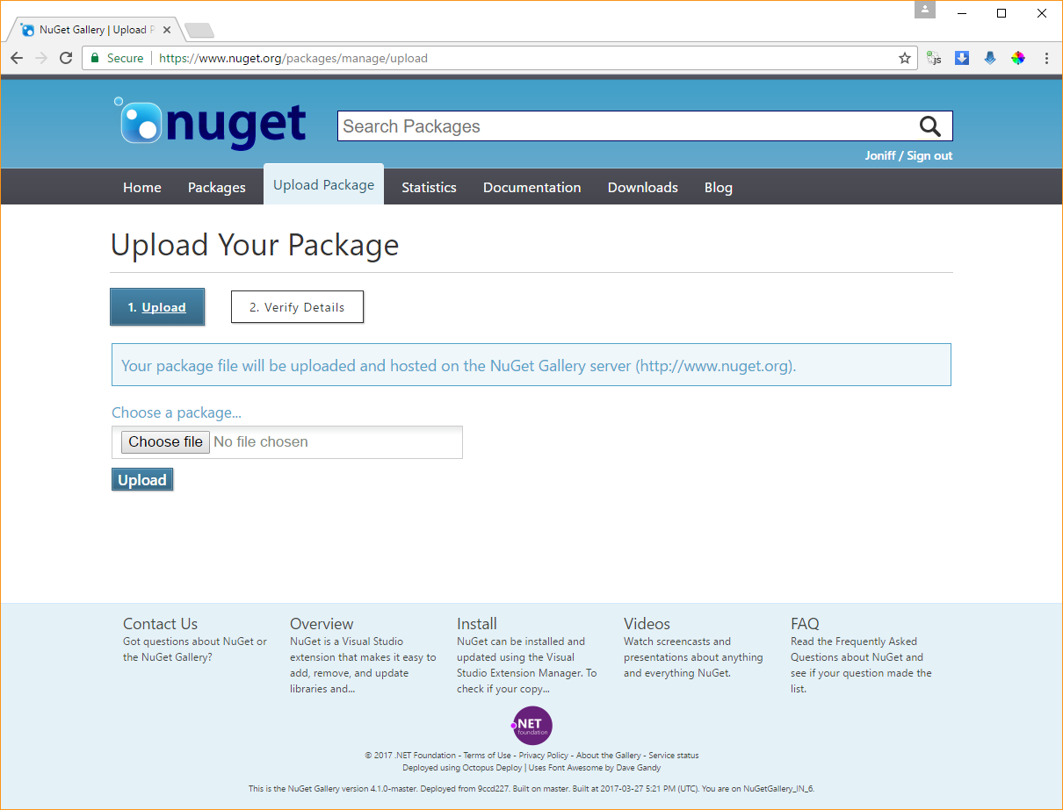
Using the NuGet website, you can upload your auto-generated NuGet package file to your account so that everyone can use

Slide 18
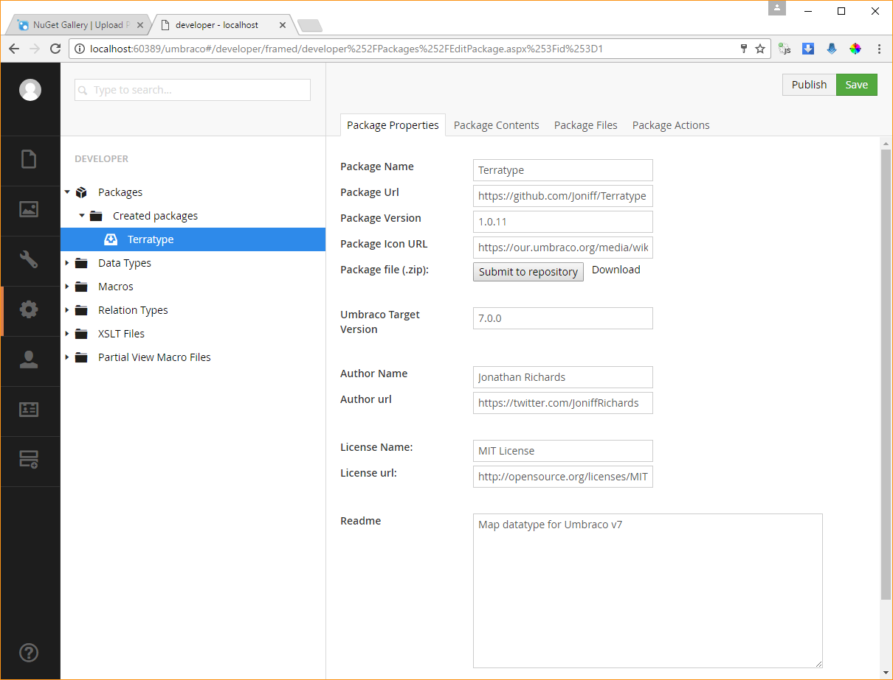
Using bog standard skills create a new Umbraco package using your test website.

Slide 19
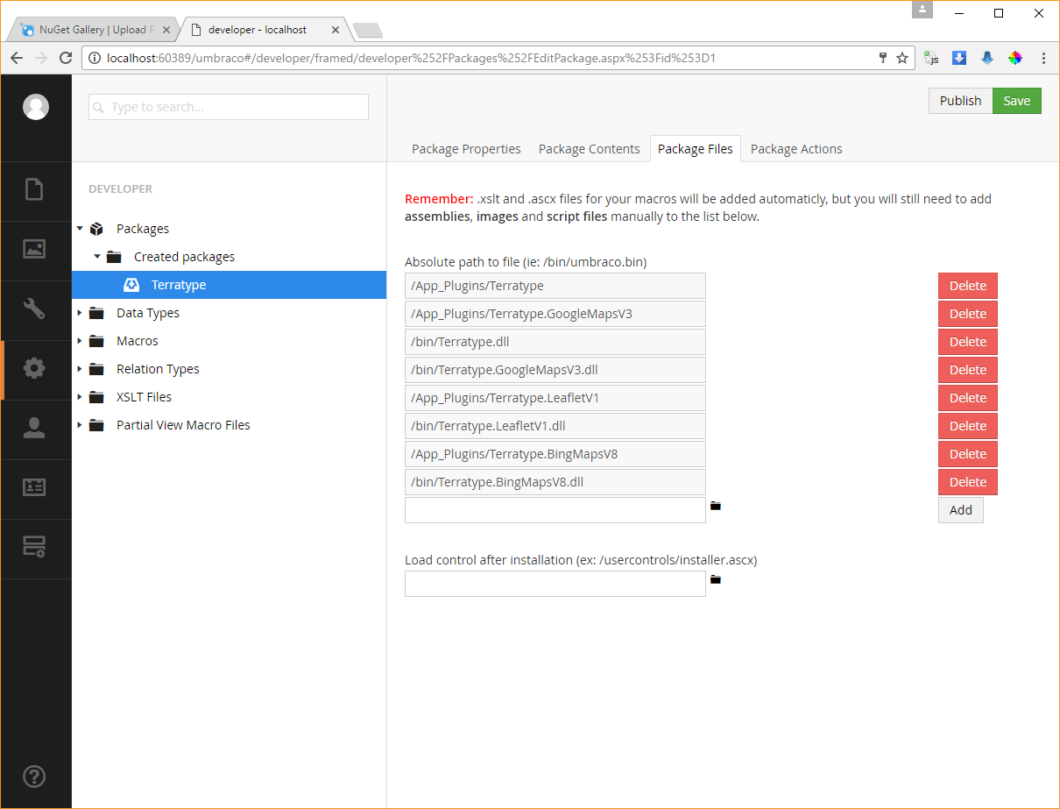
Under package files. Include all the static files in App_Plugins
Also include your dll file.
When happy, press Save and Publish buttons. You will be sent a download file that contains your new Umbraco Package. This is ready to be given to others.
NOTE: This package shown in screenshot actuall contains 4 separate plugins… there is no limit to what files you can put into an Umbraco package.

Slide 20
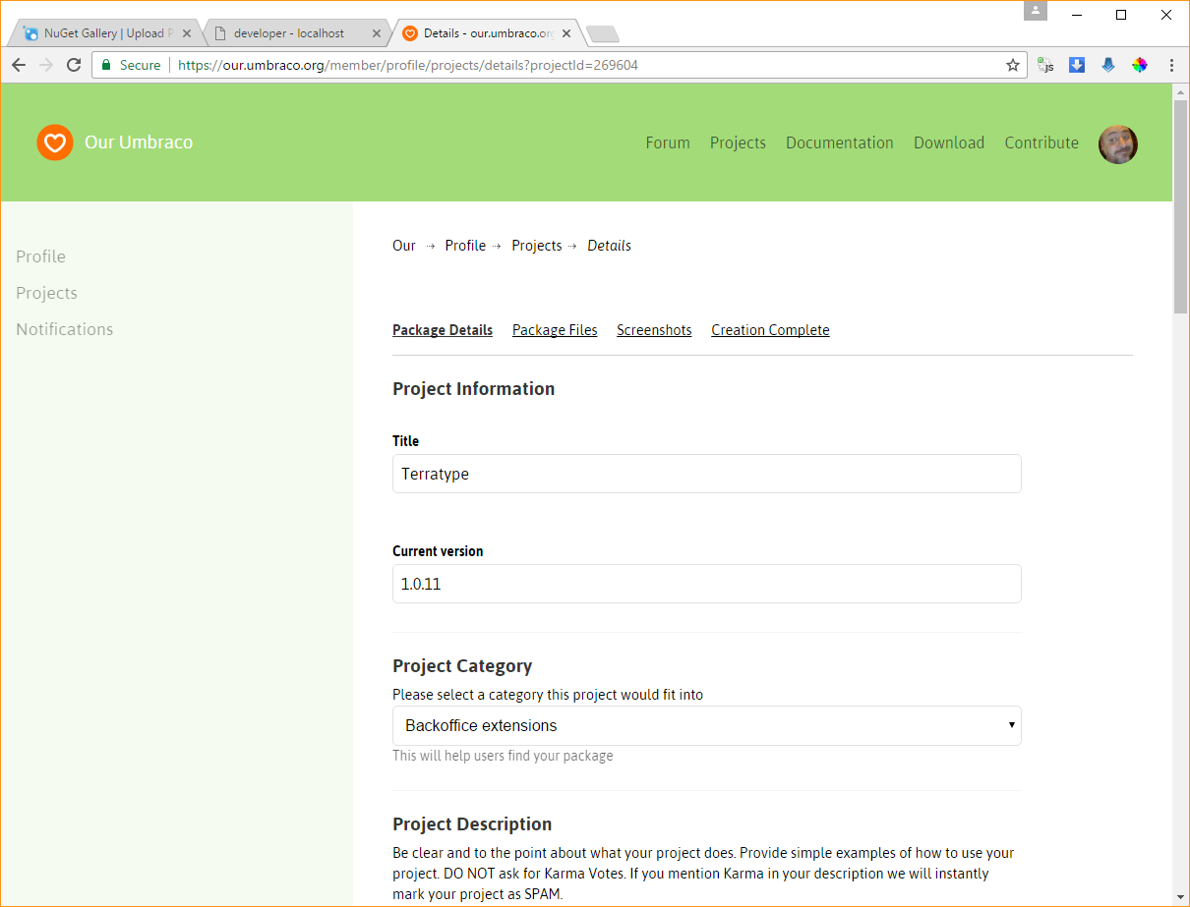
In http://our.umbraco.org you can create a new package and upload your Umbraco Package

